Slide 1


ONLINE FOOD ORDERING SYSTEM
Group—8 , ECE—A
Team members
24KB1A04R4 – P.spandana
24KB1A04g9 – K.Geethika
24KB1A04l9 – mm.nahila baig

Slide 2
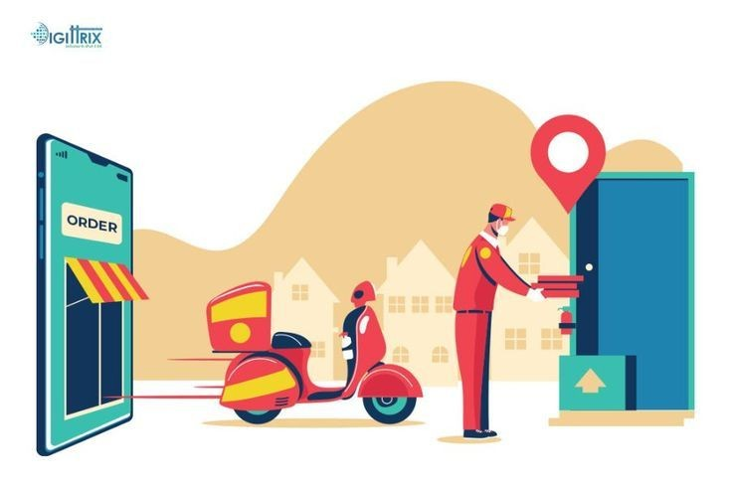
Introduction
• An online food ordering system allows customers to place food orders through a website or mobile application. • It provides a digital menu where users can browse items, customize orders, and choose delivery or pickup options. • Customers can make secure payments online using various payment methods. • The system notifies restaurants instantly, helping them prepare and manage orders efficiently. • It often includes real-time order tracking and status updates for better user experience.

Slide 3
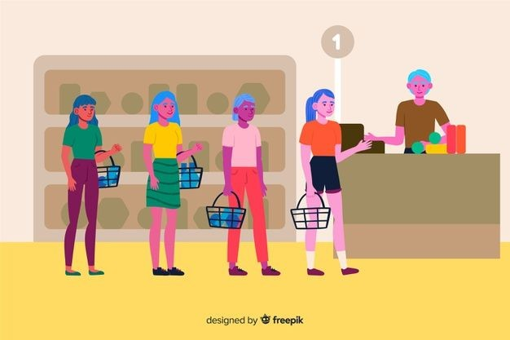
Previous food ordering system
1.Walk-in Orders Customers physically visited restaurants to place and receive their orders.
2. Phone Orders Description: Customers called restaurants to place orders for pickup or delivery.
3. Third-Party Delivery Services (pre-digital) Description: Some independent delivery services or drivers would relay orders between customers and restaurants.

Slide 4
Disadvantages of previous food ordering system
Time-consuming, especially during peak hours. Requires travel, which may be inconvenient.
Prone to miscommunication (wrong order due to unclear speech). No visual menu; hard to know all available items or prices.
Higher costs and often unreliable delivery times. No real-time tracking or updates.

Slide 5
Technologies and tools
Language : c and data structures Concepts : structures,linked lists,pointers, functions,arrays and strings Storage : file handling for saving data.

Slide 6
Working flow
Option 1: Display Menu Calls displayMenu(), which traverses the menuHead list and prints all menu items. Option 2: Place Order Shows the menu. Asks the user to input the id and quantity of items to order. Adds each item to the orderHead list using placeOrder(). User can continue adding more items by entering 1 when prompted
Option 3: Generate Bill Traverses the orderHead list. For each order, matches it to the corresponding MenuItem via the ID. Calculates and prints the cost of each item (price * quantity) and the total bill. Option 4: Exit Ends the loop and exits the program with a thank-you message.

Slide 7
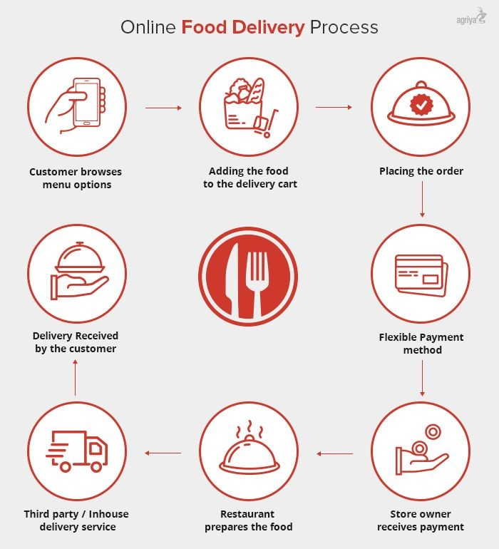
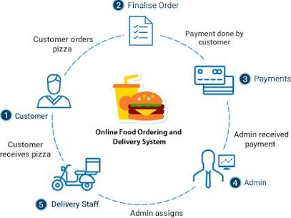
Modules In project
1. Menu Module • Browse food items by category • Search and filter options • View item details (price, ingredients, etc.) 2. Cart Module • Add/remove items to cart • Quantity management • View total cost 3. Order Management Module • Place order • Track order status (Pending, In Progress, Delivered) • Cancel or modify order (if allowed)

Slide 8
Advantages of online food ordering system
1. Convenience for Customers • Orders can be placed anytime, from anywhere. • Easy browsing of menu items with descriptions and images. 2. Time-Saving • Faster than visiting or calling a restaurant. • Reduces waiting time with pre-ordering and scheduling options. 3. Increased Sales for Restaurants • Wider customer reach through online platforms. • Opportunity for repeat business through loyalty programs and discounts.
4. Order Accuracy • Reduces human error compared to phone orders. • Clear digital records of what was ordered. 5. Real-Time Tracking • Customers can track their order status and delivery in real time. 6. Better Data Management • Easy to analyze customer preferences and sales trends. • Helps restaurants make informed business decisions.

Slide 9
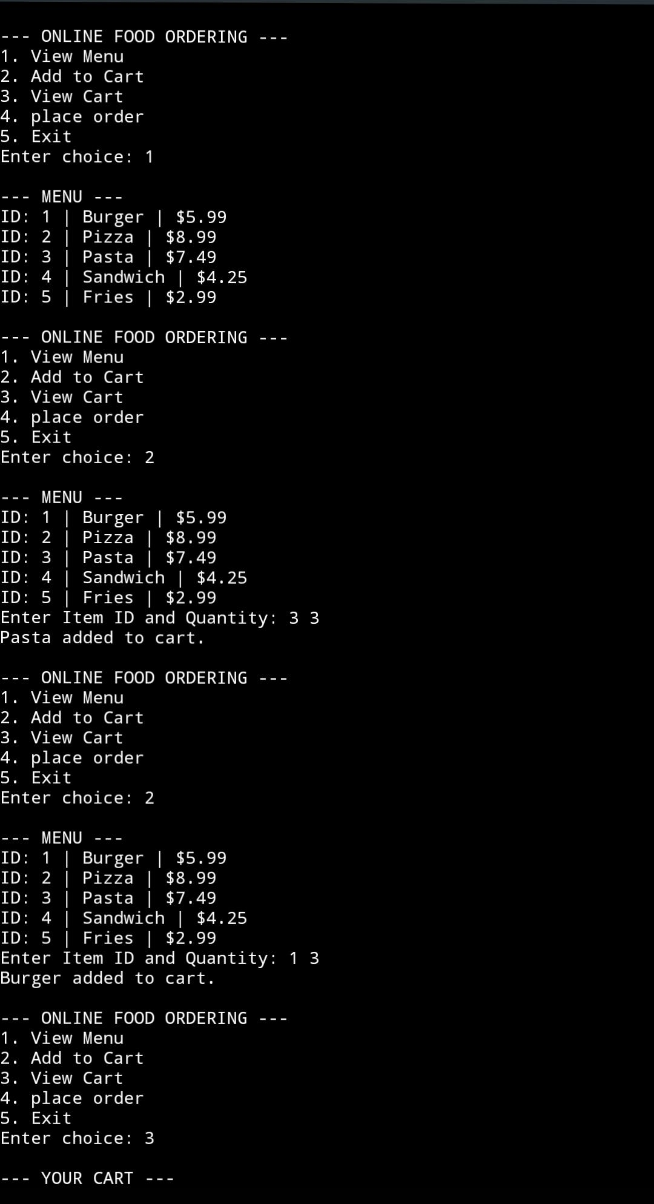
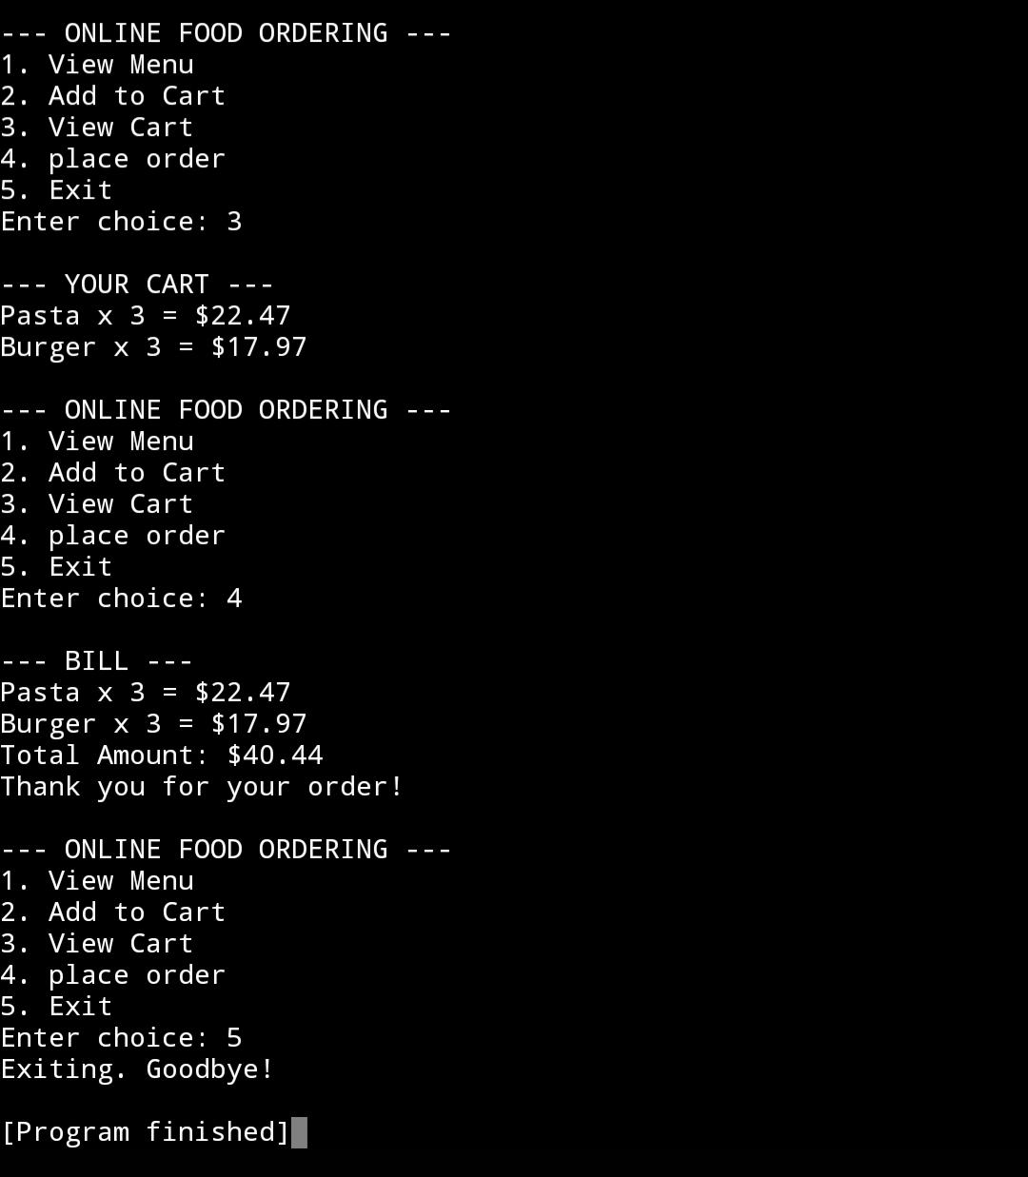
Output images

Slide 10
Conclusion
The Online Food Ordering System has revolutionized the way customers interact with restaurants by offering a fast, convenient, and user-friendly platform to browse menus, place orders, and make payments. It benefits both customers and restaurant owners by streamlining operations, enhancing customer satisfaction, and increasing sales potential. With the growing reliance on digital services, such systems are not just a convenience but a necessity for modern food businesses aiming to stay competitive and responsive in a rapidly evolving market.

Slide 11
Thank you 😊

